Slide 1
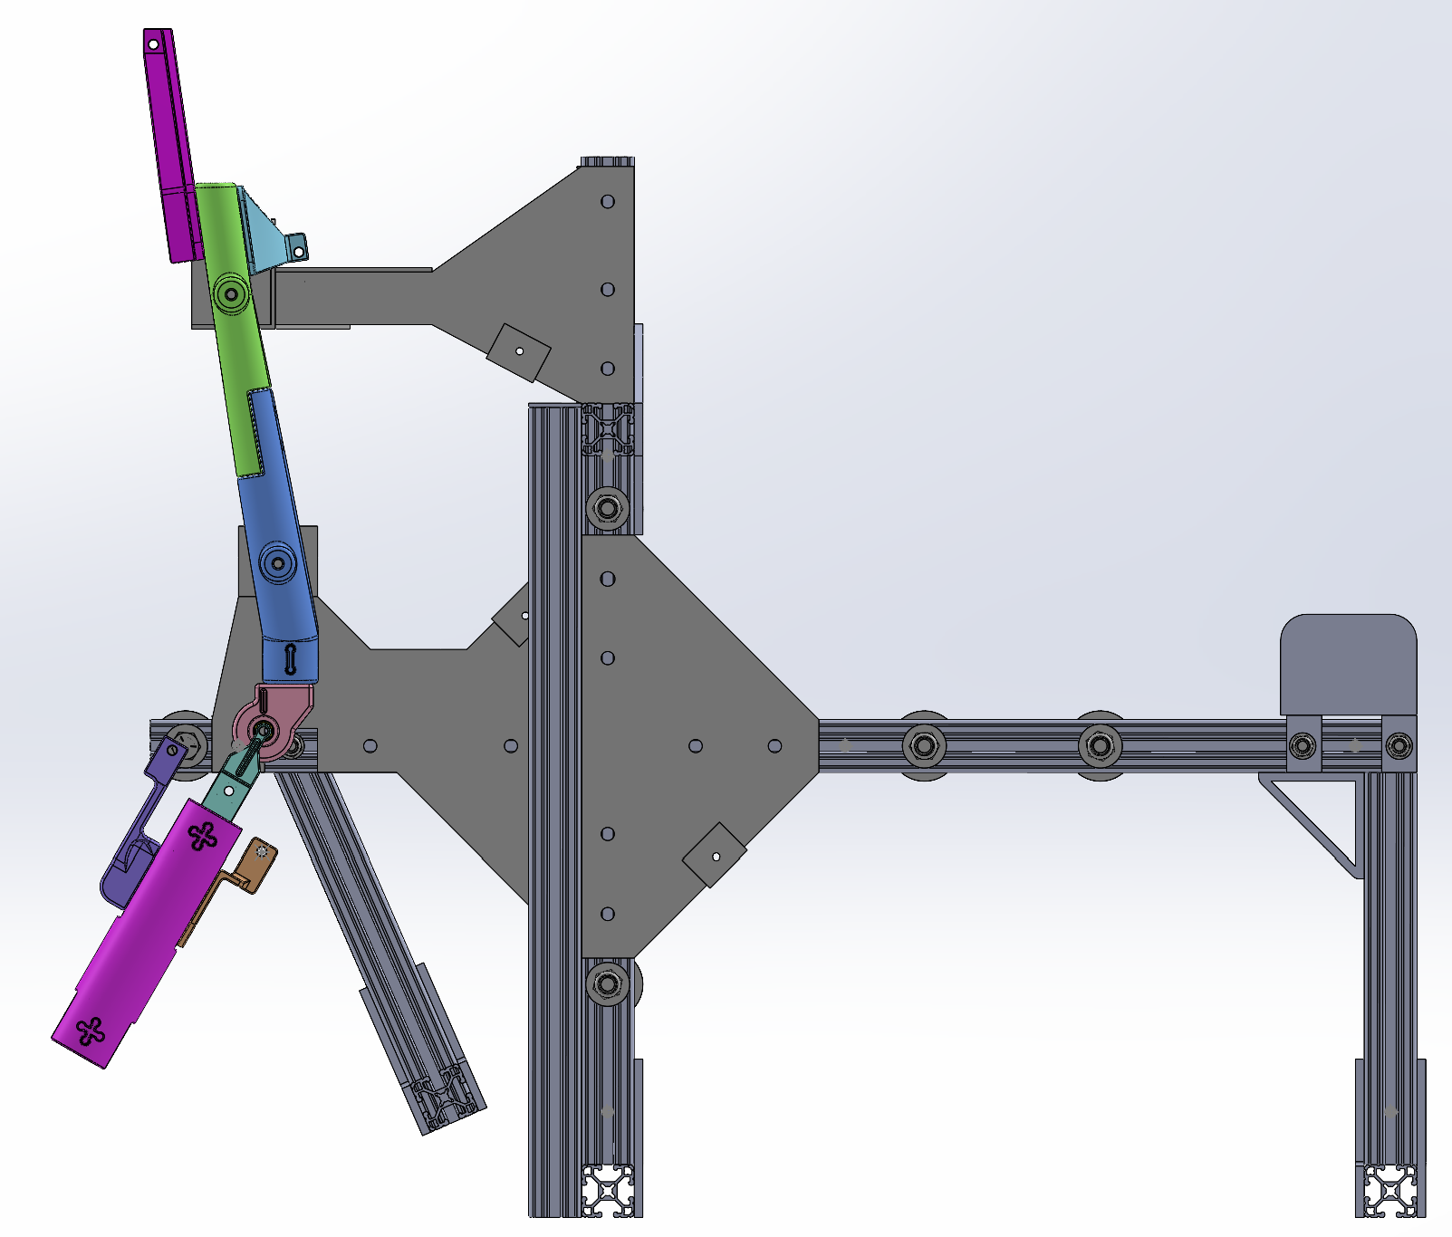
Test jig assembly
BPA
Femur
Winch housing
Tibia
Winch cable
Swing arm
Load cell

